Slide 1
CS210 Term Project Presentation
Burç Güven
30667

Slide 2
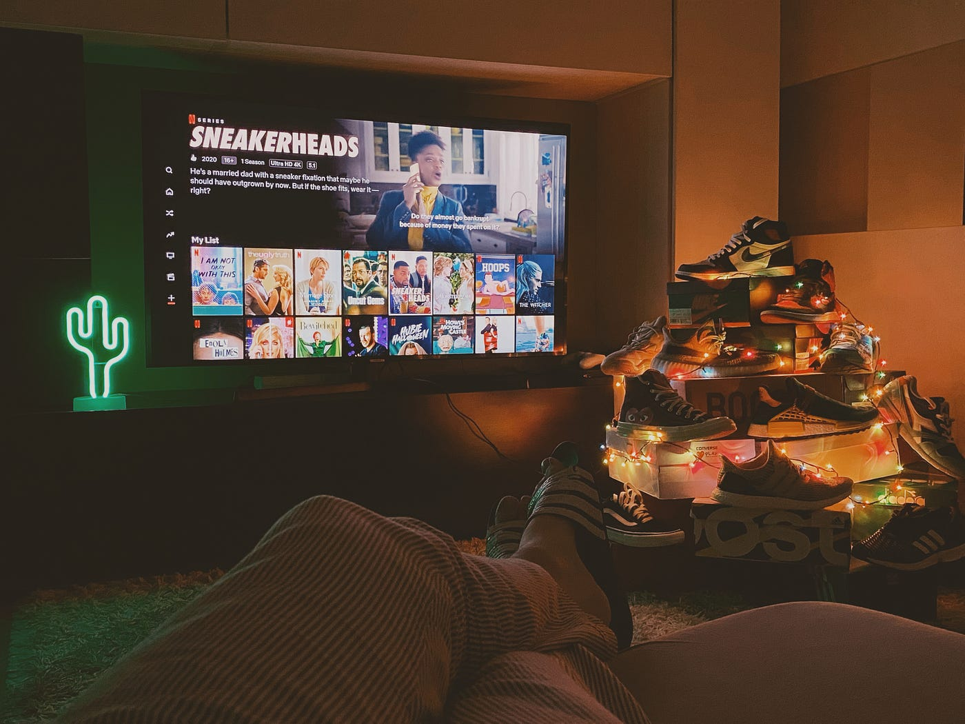

SEASONS and HOBBIES
People usually prefer doing outdoor activities such as doing sports, hanging out with friends and partying during summer time. Winter time is generally for indoor activities such as napping, reading a book or watching your favorite movies – TV series over and over again. For example, my favorite TV shows are Breaking Bad and Rick and Morty.

Slide 3


Purpose of the Project
Discovering the change of my lifestyle and understanding the shift in my hobbies during different seasons and time periods in a year

Slide 4
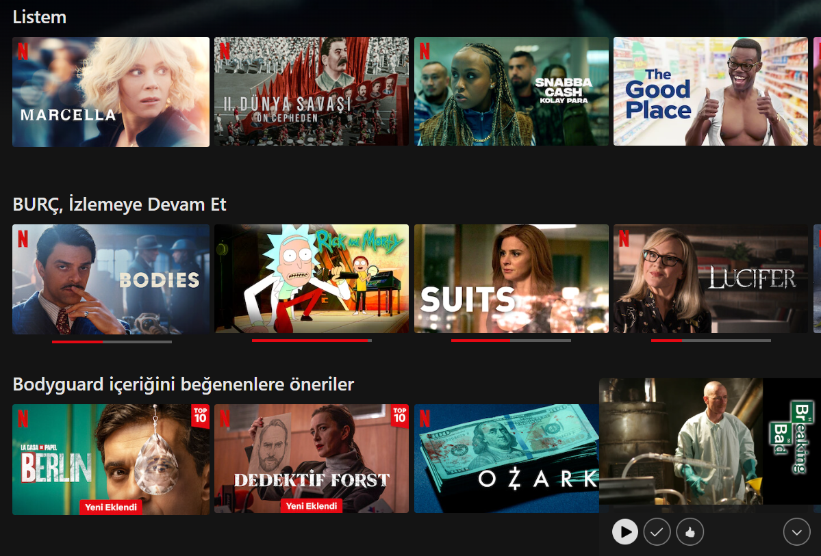
Data source that I used
My Netflix account history
All the films and TV series episodes that I have watched from Netflix
In a format of Title, Date (dd.mm.yyyy)
January 2020 - January 2024

Slide 5
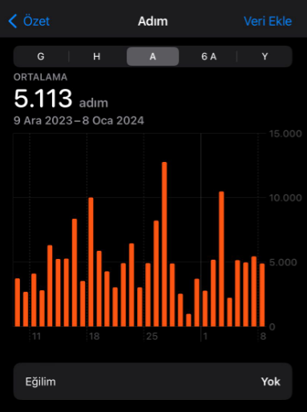
Data source that I used
My step count from Apple Health app
The number of steps that I took during different instances in a day
Formatted as devices that recored these steps, start date, end date and count value
January 2020 – January 2024

Slide 6


Hypothesis
In summer time, I prefer doing outdoor activities and hobbies involving more movement. On the other hand, in winter time, I prefer indoor activities involving less movement

Slide 7
Why did I use these resources?
NETFLIX
The time spent on Netflix watching Movies and TV shows represent the time I stayed at home doing indoor activities, pursuing a lazier and more comfortable joy time
STEP COUNT
The number of steps taken in a day represents the occurence of an outdoor activity made in that day, concluding whether a physical activity was done or not

Slide 8


FINDINGS

Slide 9
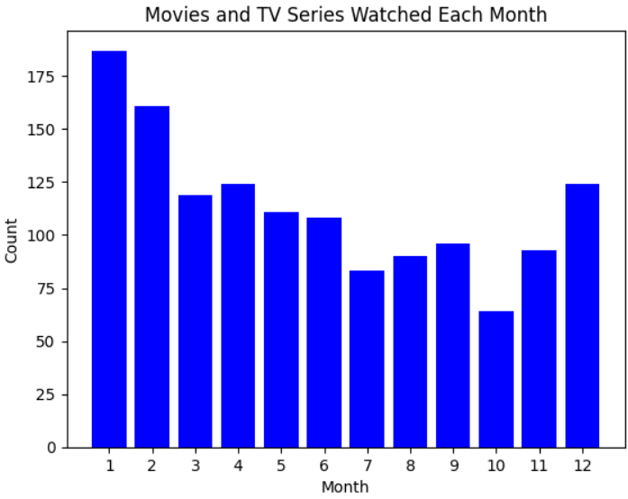
Time Period of Netflix
It is seen that I watch Netflix media the most frequently when it’s January and February
These two are winter months
I have watched more than 320 Netflix media in Januray and February between 2020-2024

Slide 10
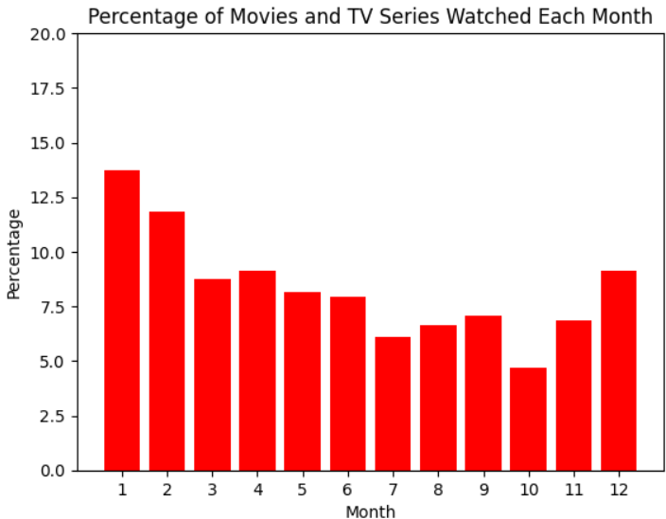
Max and Mins
The two months in the year with most amount of Netflix media:
July
October
The two months in the year with least amount of Netflix media:
January
February

Slide 11
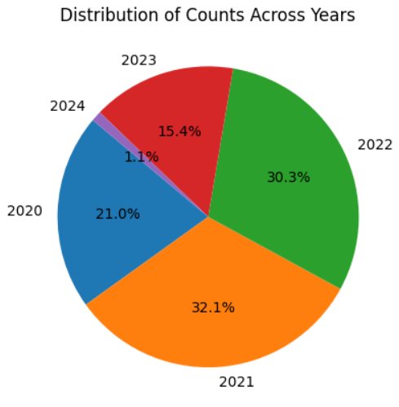
Fun Fact
The year I watched Netflix media the most was 2021
The year I studied for the national university exam was also 2021
Is this coincidence?

Slide 12
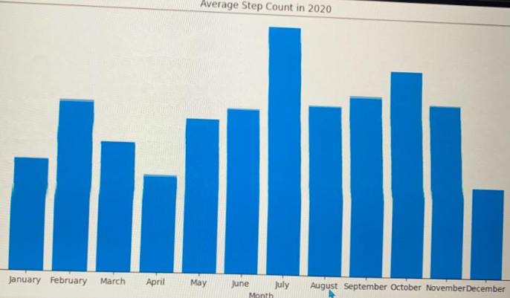
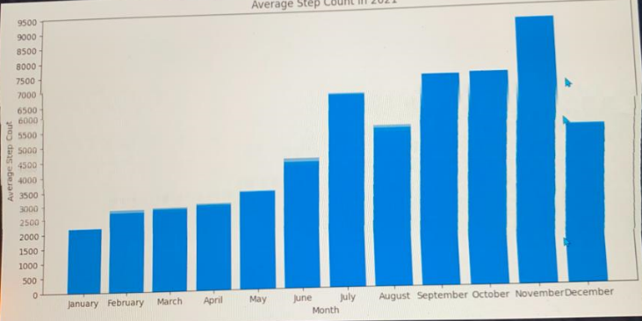
Number of Steps Taken
Average step counts in 2020
Average step counts in 2021

Slide 13
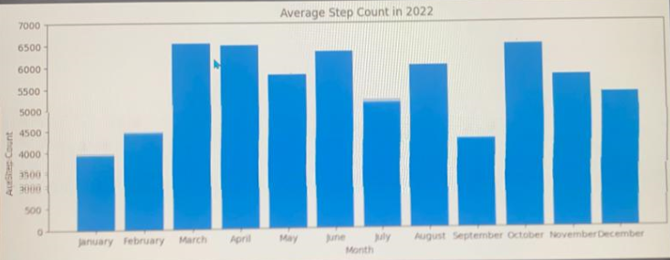
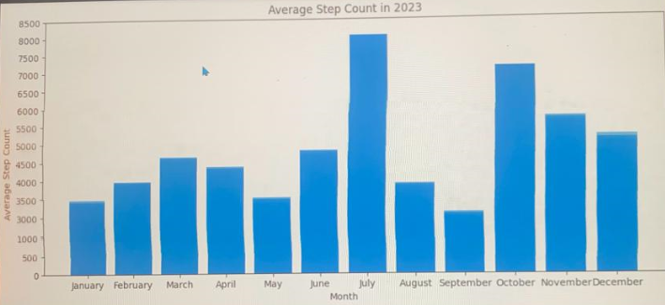
Number of Steps Taken
Average step counts in 2022
Average step counts in 2023

Slide 14
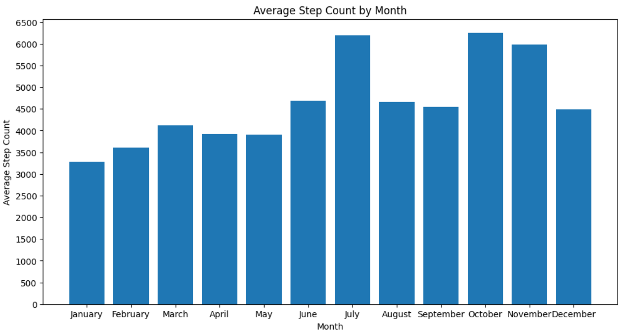
Total Average number of steps 2020-2024

Slide 15
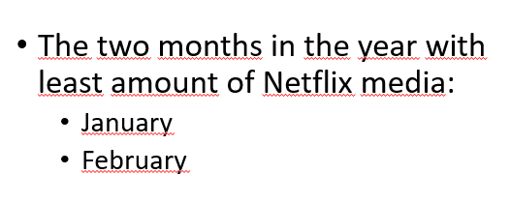
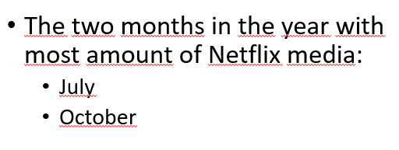
Conclusion and Correlation
TBT to slide #10
As it is seen in the previous in the previous slide, the months where I took most number of steps are July and October
The months where I tool the most number of steps are January and February
Now let’s make a time travel back to slide number 10

Slide 16
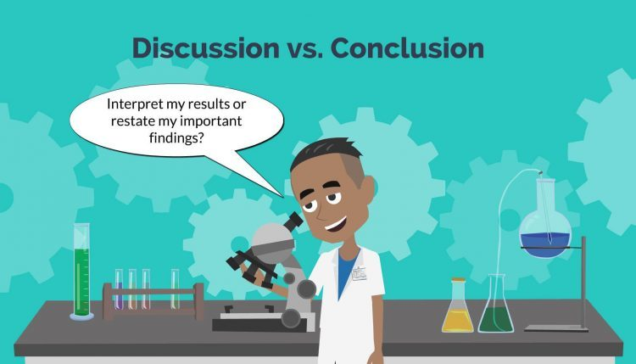
CONCLUSION
To sum up, it is clear that I prefer to watch movies and TV shows from Netflix mostly on winter (January-February) and I generally don’t wacth many films and TV shows on summer period
On the other hand, it is seen that my physical activity level arises in summer period and decreases during winter period

Slide 17


We just proved the hypothesis!!!
So, based on my findings, I proved my hypothesis and now I can say that while I enjoy outdoor activities in summer time, I prefer to do indoor activities on winter time.
And that’s how we reached to the conclusion using using Data Science and pursuing scientific methods.
BRAVO!

